Slide 1
Symmetric Cryptography
RC4 Stream Cipher
Stream Cipher
The RC4 Stream Cipher:
RC4 is a stream cipher designed in 1987 by Ron Rivest. It is a variable key-size stream cipher with byte-oriented operations. The algorithm is based on the use of a random permutation.
The cipher can be expected to run very quickly in software.
RC4 is used in WEP (Wired Equivalent Privacy) and WPA (WiFi Protected Access ), which are encryption protocols commonly used on wireless routers. Secure Socket Layer (SSL):
Transport Layer Security (TLS)
WEP (Wireless Equivalent Protocol) and WPA (Wi-Fi Protected Access).
File encryption
BitTorrent protocol encryption: to encrypt the BitTorrent protocol.
Microsoft Office XP
RC4 was originally very widely used due to its simplicity and speed.
Notes:
It is popular and works very quickly. Hence most of the users use RC4 algorithm

Slide 2
Symmetric Cryptography
RC4 Stream Cipher
For Encryption, enter the Plain text and Secret Key
Encryption algorithm make use KSA(Key stream scheduling ) and PRGA(Pseudo Random generator algorithm). Using KSA and PRGA algorithm the secret key is converted to KeyStream
Plain text ⊕ KeyStream (byte by byte) = Cipher Text

Slide 3
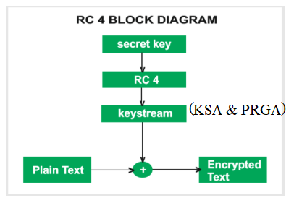
Block Diagram

Slide 4
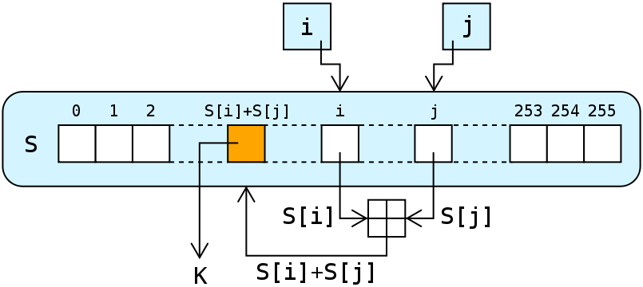
Symmetric Cryptography
RC4 Stream Cipher
RC4 Procedure
The RC4 algorithm:
A variable-length key of from 1 to 256 bytes (8 to 2048 bits) is used to initialize a 256-byte state vector S, with elements S[0], S[1],..., S[255]. For encryption and decryption, a byte K is generated from S by selecting one of the 255 entries in a systematic fashion. As each a new generated value of K, the entries in S are once again permuted.
Step 1: Initialization of S
To begin, (a) the entries of S are set equal to
the values from 0 through 255 in ascending
order; that is; S[0] = 0, S[1] = 1,...,S[255] = 255.
(b) A temporary vector, T, is also created.
If the length of the key K is 256 bytes,
then K is transferred to T. Otherwise, for
a key of length keylen bytes,
the first keylen elements of T are copied from K
and then K is repeated as many times as necessary to fill out T.
Notes:
AES, DES are block ciphers, where we encrypt in block

Slide 5
Symmetric Cryptography
RC4 Stream Cipher
State The preliminary operations can be summarized as follows:
The State Vector is represented by s[i].
The Temporary Vector is represented by T[i]
Number of Iterations =Size of the s-array
Say the state vector size is 256.
for i = 0 to 255 do
S[i] = i;
T[i] = K[i mod keylen];
Step 2: Key Scheduling Algorithm
Next we use T to produce the initial permutation of S. This involves starting with S[0] and going through to S[255], and, for each S[i], swapping S[i] with another byte in S according to a scheme dictated by T[i]:
j = 0;
for i = 0 to 255 do
j = (j + S[i] + T[i]) mod 256;
Swap (S[i], S[j]);
Because the only operation on S is a swap, the only effect is a permutation. S still contains all the numbers from 0 through 255.
Notes:
Say if the size of the vector is 256 , the number of iterations is also 256
If the size of 8, the number of iterations is 0 to 7

Slide 6
Symmetric Cryptography
RC4 Stream Cipher
Step 3: PRGA Algorithm
Once the S vector is initialized, the input key is no longer used. Stream generation involves cycling through all the elements of S[i], and, for each S[i], swapping S[i] with another byte in S according to a scheme dictated by the current configuration of S. After S[255] is reached, the process continues, starting over again at S[0]:
Number of iterations=Size of Key
i, j = 0;
while (true)
i = (i + 1) mod 256;
j = (j + S[i]) mod 256;
Swap (S[i], S[j]);
t = (S[i] + S[j]) mod 256;
K = S[t]; //K is the KeyStream
Step 4: Encryption and Decryption
To encrypt, XOR the value K with the next byte of plaintext. To decrypt, XOR the value K with the next byte of ciphertext.
Cipher Text= PlainText ⊕ KeyStream
To decrypt,
Plain Text= CipherText ⊕ KeyStream
Notes:
Say if the size of the vector is 256 , the number of iterations is also 256
If the size of 8, the number of iterations is 0 to 7

Slide 7
Symmetric Cryptography
RC4 Stream Cipher
j = 0;
for i = 0 to 255 do
j = (j + S[i] + T[i]) mod 256;
Swap (S[i], S[j]);
Example:
PT=[ 1 2 2 2 ]
Key=[1 2 3 6]
Consider S array of length 8
S=[0 1 2 3 4 5 6 7]
T=[1 2 3 6 1 2 3 6]
Apply KSA Algorithm,
i =0
j = 0
S=[0 1 2 3 4 5 6 7]
T=[1 2 3 6 1 2 3 6]
for i=0 to 7 do
j=( 0 + S[0] + T[0] ) mod 8
j= (0+0+1) mod 8 =1
Swap(S[0], S[1] )
After Swap
S=[1 0 2 3 4 5 6 7]
T=[1 2 3 6 1 2 3 6]
i =1
j = 1
S=[1 0 2 3 4 5 6 7]
T=[1 2 3 6 1 2 3 6]
for i=1 to 7 do
j=( 1 + S[1] + T[1] ) mod 8
j= (1+0+2) mod 8 =3
Swap(S[1], S[3] )
After Swap
S=[1 3 2 0 4 5 6 7]
T=[1 2 3 6 1 2 3 6]
i =2
j = 3
S=[1 3 2 0 4 5 6 7]
T=[1 2 3 6 1 2 3 6]
for i=2 to 7 do
j=( 3 + S[2] + T[2] ) mod 8
j= (3+2+3) mod 8 =0
Swap(S[2], S[0] )
After Swap
S=[2 3 1 0 4 5 6 7]
T=[1 2 3 6 1 2 3 6]
Notes:
Temporary vector is got from the Secret Key

Slide 8
Symmetric Cryptography
RC4 Stream Cipher
j = 0;
for i = 0 to 255 do
j = (j + S[i] + T[i]) mod 256;
Swap (S[i], S[j]);
Example:
i =3
j = 0
S=[2 3 1 0 4 5 6 7]
T=[1 2 3 6 1 2 3 6]
for i=3 to 7 do
j=( 0 + S[3] + T[3] ) mod 8
j= (0+0+6) mod 8 =6
Swap(S[3], S[6] )
After Swap
S=[2 3 1 6 4 5 0 7]
T=[1 2 3 6 1 2 3 6]
i =4
j = 6
S=[2 3 1 6 4 5 0 7]
T=[1 2 3 6 1 2 3 6]
for i=4 to 7 do
j=( 6 + S[4] + T[4] ) mod 8
j= (6+4+1) mod 8 =3
Swap(S[4], S[3] )
After Swap
S=[2 3 1 4 6 5 0 7]
T=[1 2 3 6 1 2 3 6]
i =5
j = 3
S=[2 3 1 4 6 5 0 7]
T=[1 2 3 6 1 2 3 6]
for i=5 to 7 do
j=( 3 + S[5] + T[5] ) mod 8
j= (3+5+2) mod 8 =2
Swap(S[5], S[2] )
After Swap
S=[2 3 5 4 6 1 0 7]
T=[1 2 3 6 1 2 3 6]

Slide 9
Symmetric Cryptography
RC4 Stream Cipher
Example:
j = 0;
for i = 0 to 255 do
j = (j + S[i] + T[i]) mod 256;
Swap (S[i], S[j]);
i =6
j = 2
S=[2 3 5 4 6 1 0 7]
T=[1 2 3 6 1 2 3 6]
for i=6 to 7 do
j=( 2 + S[6] + T[6] ) mod 8
j= (2+0+3) mod 8 =5
Swap(S[6], S[5] )
After Swap
S=[2 3 5 4 6 0 1 7]
T=[1 2 3 6 1 2 3 6]
i =7
j = 5
S=[2 3 5 4 6 0 1 7]
T=[1 2 3 6 1 2 3 6]
for i=7 to 7 do
j=( 5 + S[7] + T[7] ) mod 8
j= (5+7+6) mod 8 =2
Swap(S[7], S[2] )
After Swap
S=[2 3 7 4 6 0 1 5]
T=[1 2 3 6 1 2 3 6]

Slide 10
Symmetric Cryptography
RC4 Stream Cipher
Example:
i, j = 0;
while (true)
i = (i + 1) mod 8;
j = (j + S[i]) mod 8;
Swap (S[i], S[j]);
t = (S[i] + S[j]) mod 8;
K = S[t]; //K is the
S=[2 3 7 4 6 0 1 5]
i = 0 ; j = 0
i=(0 + 1) mod 8 =1
j = (0 + S[1 ] ) mod 8
j = (0 + 3 ) mod 8 =3
Swap(S[1], S[3] )
S=[2 4 7 3 6 0 1 5]
t = (S[1] + S[3]) mod 8;
t = (4+3) mod 8 =7
K = S[t];
K=S[7] =5
S=[2 4 7 3 6 0 1 5]
i = 1 ; j = 3
i=(1 + 1) mod 8 =2
j = (3 + S[2 ] ) mod 8
j = (3 + 7 ) mod 8 =2
Swap(S[2], S[2] )
S=[2 4 7 3 6 0 1 5]
t = (S[2] + S[2]) mod 8;
t = (7+7) mod 8 =6
K = S[t];
K=S[6] =1
S=[2 4 7 3 6 0 1 5]
i = 2 ; j = 2
i=(2 + 1) mod 8 =3
j = (2 + S[3 ] ) mod 8
j = (2 + 3 ) mod 8 =5
Swap(S[3], S[5] )
S=[2 4 7 0 6 3 1 5]
t = (S[3] + S[5]) mod 8;
t = (0+3) mod 8 =3
K = S[t];
K=S[3] =0

Slide 11
Symmetric Cryptography
RC4 Stream Cipher
Example:
i, j = 0;
while (true)
i = (i + 1) mod 8;
j = (j + S[i]) mod 8;
Swap (S[i], S[j]);
t = (S[i] + S[j]) mod 8;
K = S[t]; //K is the
S=[2 4 7 0 6 3 1 5]
i = 3 ; j = 5
i=(3 + 1) mod 8 =4
j = (5 + S[4 ] ) mod 8
j = (5 + 6 ) mod 8 =3
Swap(S[4], S[3] )
S=[2 4 7 6 0 3 1 5]
t = (S[4] + S[3]) mod 8;
t = (0+6) mod 8 =6
K = S[t];
K=S[6] =1

Slide 12
Symmetric Cryptography
RC4 Stream Cipher
Example:
i, j = 0;
while (true)
i = (i + 1) mod 8;
j = (j + S[i]) mod 8;
Swap (S[i], S[j]);
t = (S[i] + S[j]) mod 8;
K = S[t]; //K is the
Encrypt
PT= [1 2 2 2 ]
KeyStream =[5 1 0 1]
0001 0010 0010 0010 PT ⊕
0101 0001 0000 0001 KS
---------------------------------
0100 0011 0010 0011 =CT
---------------------------------
CT= [4 3 2 3 ]
Decrypt
CT= [4 3 2 3 ]
KeyStream =[5 1 0 1]
0100 0011 0010 0011 CT ⊕
0101 0001 0000 0001 KS
---------------------------------
0001 0010 0010 0010 =PT
---------------------------------
PT=[1 2 2 2 ]

